Slide 1
Medi Co.
Group 03

Slide 2
Medi Co. - Our Team
Automatic Medication Dispensing Management System
Anthony Reda
Hyun Jun Kim
Kevin Tu
Abdul Moqueet
Robin Lopez
Dhruv Patel

Slide 3
1. Overview
Many inefficiency and error drives from traditional medication administration system
These error drastically increase severity, mortality and morbidity rate of patients
The current fast-paced environment and dynamic patients condition require sophisticated hardware

Slide 4
2. Users/Customers
Medical Professional (Registered in the system)
Nurses
Doctors
Physicians
Pharmacists
Administrator
Due to security reason, only registered medical professional and administrator has access to the system

Slide 5
3. Goals
Reduce human error
Increase efficiency of medical professionals
Reduce cost for patients
Reduce cost for the hospital

Slide 6
4. Requirement Identification
Elicitation Techniques:
Interviews
One on One interview were conducted
With primary stakeholders of the system
Doctors, Nurses and Medical Suppliers
Questionnaires
Mainly encompasses secondary stakeholders of the system
Patients
Observations
Observations of daily tasks routine for doctors and nurses were conducted
To design a solution which would save time and money.

Slide 7
Functional Requirements
1.1.1. Login method for (Hospital Staff, System Administrator and the Medical Supplier)
1.1.1.1. Hospital Staff members and Medical Supplier would use their RFID tag along with the unique PIN to login to the system while the Systems Administrator would be able to login with RSA cryptosystem and would have remote access to the on-board computer systems.
1.1.1.2. Once logged in each entity would have their own dashboard.
1.1.1.2.1. System Administrator would have complete access to the system logs.
1.1.1.2.2. Nurses would be able to see patients assigned to them and what dosage of medication is prescribed for them by the doctor.
1.1.1.2.3. Medical Supplier would be able to see which medication stocks levels needs to be replenished.

Slide 8
Functional Requirements
1.1.1.3. Once the medication is dispensed a report containing the username, access time, type and quantity of drug as well as the patient its intended for would be sent to the hospitals database server to be kept in records.
1.1.1.4. The system would have a real time connection to the hospitals database, where it would instantly register newly added patients and any medications prescribed to them.

Slide 9
Non-Functional Requirements
1.2.1. Reliability
1.2.1.1. The system would provide an accurate amount of medication prescribed by the doctor, thus reducing any human errors in the process.
1.2.2. Usability
1.2.2.1. It is anticipated that the system will be operational 24/7, except for the narrow window when the stock levels must be replenished, which is estimated to take under 20 minutes.
1.2.2.2. In the case of an unexpected power outage the system will be equipped with Uninterrupted Power Supply System (UPS) which will ensure its continuous availability.
1.2.2.3. The system will support a user-friendly interface, designed specifically for Medi Co to provide easy medication dispensing.

Slide 10
Non-Functional Requirements
1.2.3. Security
1.2.3.1. The system will utilize the industry standard of 256 bits Advanced Encryption Standard (AES), while accessing data from hospitals database server to ensure data safety.
1.2.3.2. The system also supports automatic logout after 30 second of inactivity.
1.2.4. Performance
1.2.4.1. The system would be able to perform the entire task from, logging in to the system to dispensing of the correct medicinal dosage, well under 3 minutes.

Slide 11
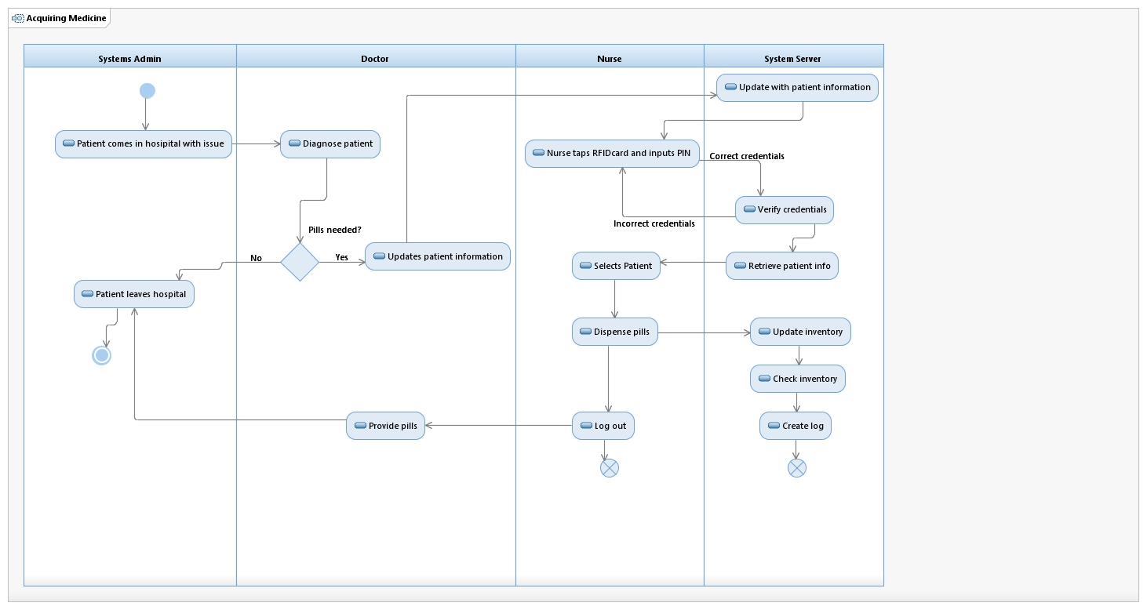
5. Modelling Functional Requirements

Slide 12
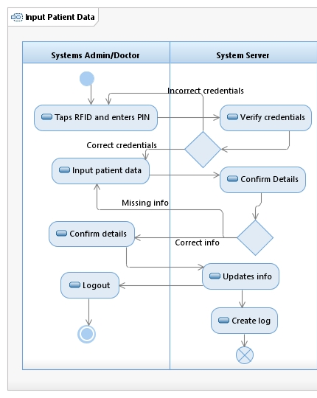

Slide 13
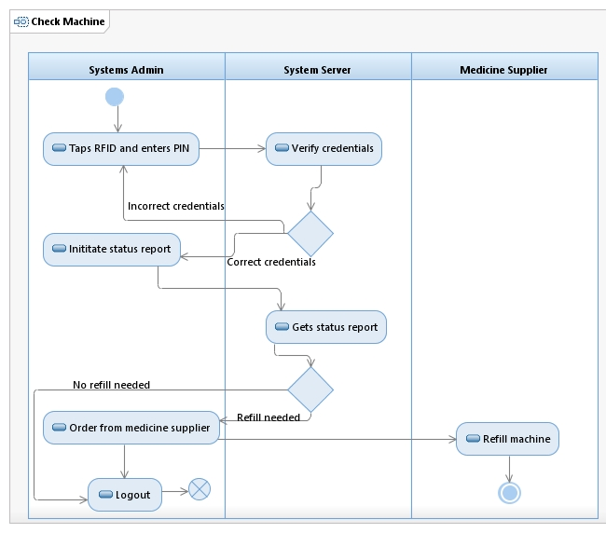

Slide 14
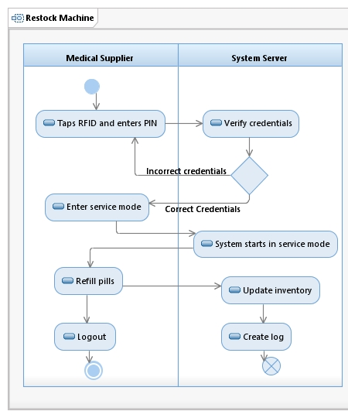

Slide 15
6. Temporal & State Events
Temporal Event
User logged out of system after 10 minutes of inactivity
System generates a monthly inventory report
State Event
Medication inventory has run low or out completely

Slide 16
6. External Events
Medical Professional wants to log into the dispenser system
Medical Supplier puts system into Service Mode
Medical Professional acquires medicine from the dispenser
Medical Professional registers a new patient
Medical Supplier restocks medication inventory
Medical Professional checks inventory levels of the dispenser
Medical Professional submits order for more medication
Medical Professional changes patient’s information
Patient provides information to Medical Professionals

Slide 17
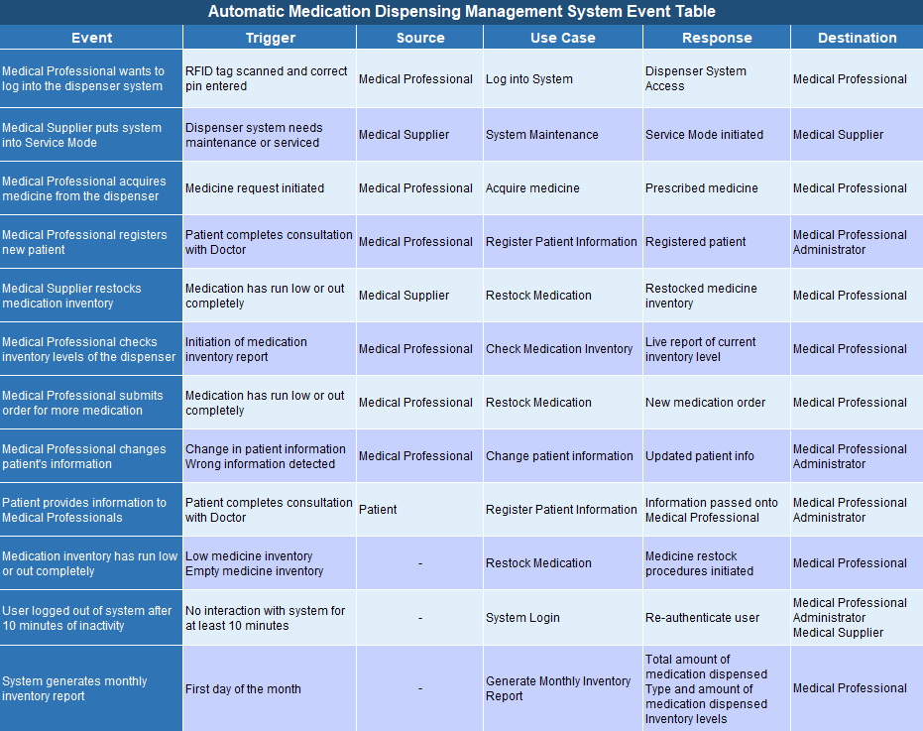

Slide 18
7. Use Cases
1. Acquire Medicine
Use Case Name: | Acquire medicine
Scenario: | Medical professional acquires medicine from the dispenser
Triggering Event: | User initiates request for medicine in the despenser terminal
Brief Description: | A medical professional accesses the despenser terminal via RFID tag and a PIN, once they have gained access to the system they may input the patient data and acquire relative medication.
Actors: | Medical professional (User)
Related Cases: | Check medication inventory
Stakeholders: | Medical Suppliers who restock the dispenser Administrators who supervise the user and patient records
Preconditions: | Patient data must exist in the system Medicine must be in stock User credentials must exist in the system
Postconditions: | Inventory of medicine must be updated Transaction of acquired medicine must be recorded (from which user, for what patient, and what medicine)

Slide 19
1. Acquire Medicine
Flow of Activities: | Actors System
Exception Conditions: | 1. If the user’s PIN is invalid, the user cannot gain access 2.3 If a medication has run out it will be displayed as such, the user will not be able to select that medication.
1. User taps RFID tag onto RFID reader | 1. System verifies User by requesting User’s PIN
2. User inputs specific patient data | 2.1 The system begins a new transaction 2.2 The system returns available medication for specific patient 2.3 System displays which required medication is in stock
3. User selects patient’s necessary medicine to be dispensed | 3.1 System begins dispensing process 3.2 System records transaction details
4. User picks up the medicine | 4. Transaction Completed

Slide 20
2. Register Patient Information
Use Case Name: | Register Patient Information
Scenario: | New patient gets hospitalized and received prescription from the responsible doctor
Triggering Event: | When patient finish consultation with doctor
Brief Description: | A medical professional accesses the terminal via RFID tag and a PIN, once they gained access to the system, the medical professional register new patient with all personal information, diagnosis, and required medication and dosage
Actors: | Medical professional
Related Cases: | N/A
Stakeholders: | Medical professionals who input the data Administrators who supervise the user and patient records
Preconditions: | Patient data must not exist Completed consultation with the doctor
Postconditions: | Medical professional has entered information correctly Personal Information Diagnosis Prescription

Slide 21
2. Register Patient Information
Flow of Activities: | Actors System
Exception Conditions: | 1. If the user’s PIN is invalid, the user cannot gain access 2.1 All personal information is required such as: SIN number, medical number. If all personal information is not present transaction cannot be completed.
1. User taps RFID tag onto the reader | 1.1 System verifies User by requesting User’s PIN
2. User register patient | 2.1 The system requires user to enter personal information 2.2 Then requires user to enter diagnosis from the doctor 2.3 Then requires user to enter prescription of the patient
3. System confirmation | 3.1 Upon finishing entering patient’s information, system ask user to double check and look for any missing required information 3.2 Finish registering patient

Slide 22
3. Restock Medication
Use Case Name: | Restock Medication
Scenario: | Medical suppliers refill medication inventory
Triggering Event: | When a sufficient amount of medication has run low or out completely.
Brief Description: | When medication reaches a certain threshold or runs out completely, it is necessary for the dispenser to be restocked. When this happens a medical supplier employee will come to the hospital and service the dispenser.
Actors: | Medical Suppliers (User)
Related Cases: | Check medication inventory
Stakeholders: | Medication Suppliers who restock the dispensers from various medical companies
Preconditions: | User credentials must exist in the system One or more types of medication must be below the threshold for restock An order must have been placed by medical professionals at the hospital
Postconditions: | Restock of medication must be recorded in the system

Slide 23
3. Restock Medication
Flow of Activities: | Actors System
Exception Conditions: | 1. If the user’s credentials are invalid, the user cannot gain access
1. User accesses system via login credentials (medical company credentials) | 1. System verifies user in database
2. User puts the dispenser’s system into a service mode | 2. System begins service mode transaction
3. User refills medication inventory
4. User completes medication refills and exits servicing mode | 4.1 System completes service transaction 4.2 System records new inventory levels

Slide 24
4. Check Medication Inventory
Use Case Name: | Check medication inventory
Scenario: | Medical Professional checks the inventory levels of the dispenser
Triggering Event: | User initiates report of medication inventory
Brief Description: | A medical professional will access the system to view a live report of the current inventory level of each type of medication dispenser supplies. The user can then proceed to submit orders for more medication
Actors: | Medical Professional (User)
Related Cases: | Restock Medication
Stakeholders: | Medical Suppliers who receive the order for new medication Medical professionals who check inventory levels and submit orders
Preconditions: | User credentials must exist in the system
Postconditions: | N/A

Slide 25
4. Check Medication Inventory
Flow of Activities: | Actors System
Exception Conditions: | 1. If the user’s credentials are invalid, the user cannot gain access 3.1 - 3.3 If a user does not submit an order, the following System actions will not occur.
1. User taps RFID tag onto the reader | 1. System verifies User by requesting User’s PIN
2. User initiates status report of medication inventory levels | 2.1 System initiates status report transaction 2.2 System reports back all available medications and current level. 2.3 System indicates which medications are falling below the threshold or completely out.
3. User may choose to submit order for specific medication | 3.1 System will collect information on the type of medication requested 3.2 System will compile necessary info such as the dispensers location and ID 3.3 The system will send the order to the specific medical supplier
 | 4. Status report transaction is completed

Slide 26
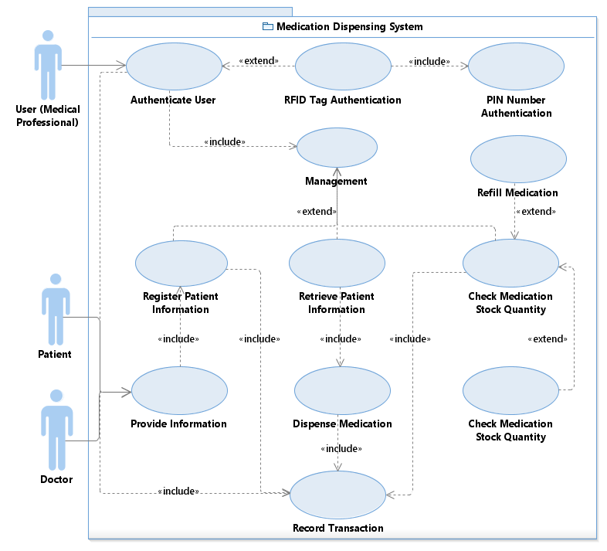
8. Use case diagram
Acquiring Medication
Registering Patient
Restocking Medication
Checking Inventory
Every Personnel are required to
authenticate before using the
system

Slide 27
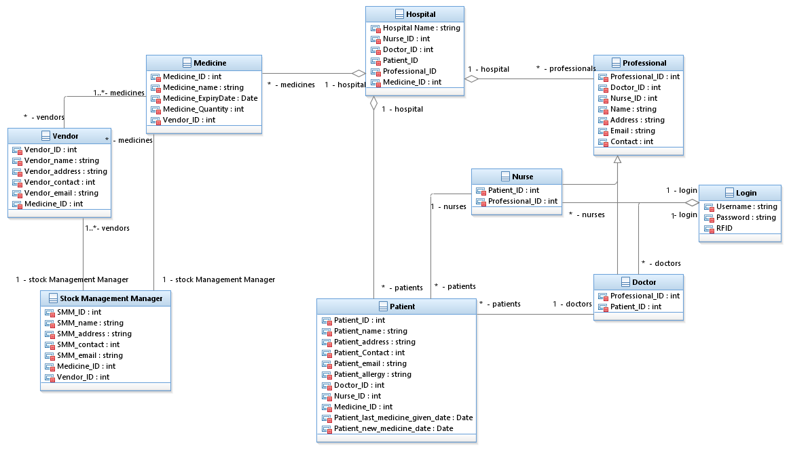
9. Conceptual Model

